Slide 1
UW-Madison Leadership Framework
Presented by:
Donna Freitag
Assistant Director of Leadership Development

Slide 2
Agenda:
Explore differences and similarities between Leadership and Management
Introduction to the UW- Madison Leadership Framework
- Grassroots initiative
- Campus-wide implementation
- Content Validation Process
- Understand and personally connect to Leadership Framework
Self-Assessment Activity
Questions and Conversation

Slide 3
UW-Madison Leadership Framework
Introduction
History
- Implemented in 2013
- Campus-Wide Model
- Research-based
- Developed by students, faculty
and staff from across campus
- Uniquely Wisconsin!
Expert Review of the Framework

Slide 4
Leadership vs Management
Leaders can be managers
Not all managers are leaders
Supplement each other and
need to be worked on concurrently
Leadership
Values
Management
Soft Skills
Technical Skills

Slide 5

UW-Madison Leadership Framework
Created to:
  Establish a shared vision and common language of what leadership means on campus
  Connect courses, programs and other opportunities
  Identify and promote practices that cultivate positive change
Notes:
The UW-Madison Leadership Framework or branded Leadership @ UW serves as the foundational leadership model for leadership programming and initiatives within CfLI. The model is also used more broadly across campus in a variety of ways such as – student leadership programming, professional development, course curriculum and goal setting etc. The Framework was created with the purpose of establishing a shared vision or common language of what leadership means on this campus. This campus-wide leadership model was based on research, grounded in the history and mission of UW-Madison as well as the Wisconsin Idea. A model that is uniquely Wisconsin.
Purpose of the leadership framework is (three fold)
To create a shared vision and common language of what leadership means on this campus
To connect courses, programs and other opportunities (so that students were learning about the framework in more than one place – throughout campus)
To identify and promote practices, approaches, and behavior that cultivate positive change

Slide 6
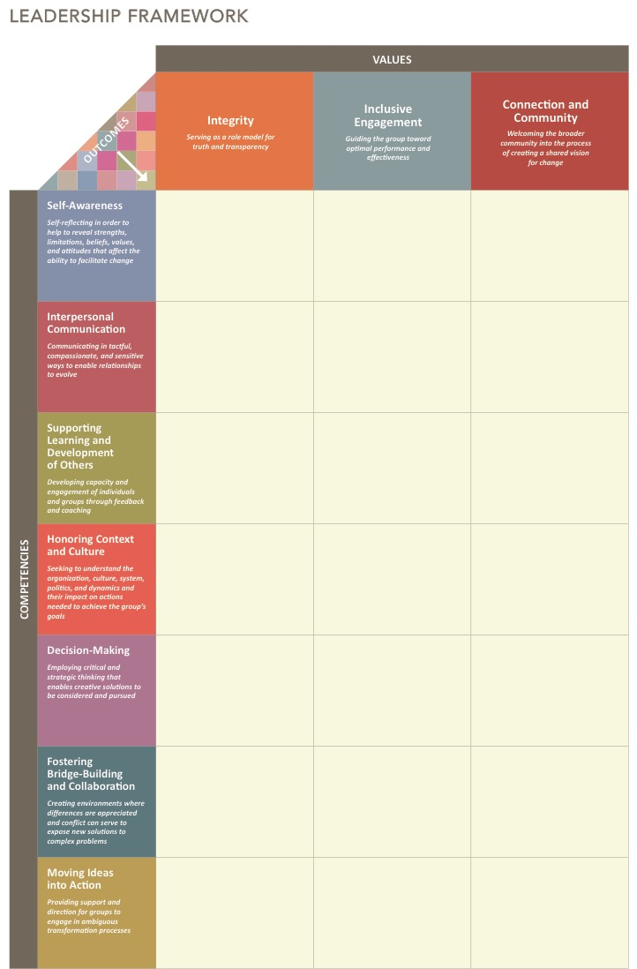
Leadership Framework
Foundational Principles
Action Oriented: Not Solely Based on Authority
Context Matters: Requires Unique Engagement
Positive Change: In Beliefs, Values & Behaviors
Values
Integrity
Inclusive Engagement
Connection and Community
Competencies
Self-Awareness
Interpersonal Communication
Supporting Learning and Development of Others
Honoring Context and Culture
Decision-Making
Fostering Bridge-Building and Collaboration
Moving Ideas into Action

Slide 7
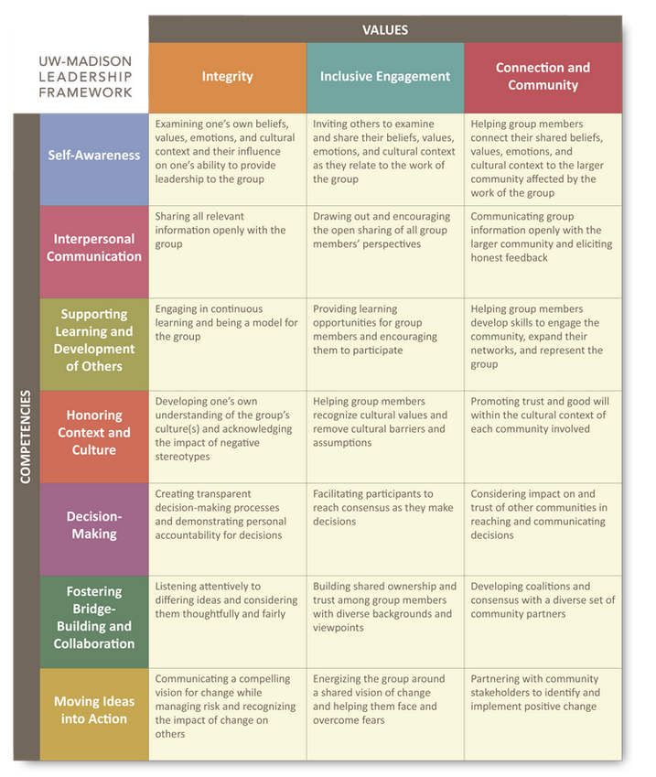
3 Values-based on three institutional and universal leadership values
7 Competencies-rooted in leadership research and theory

Slide 8
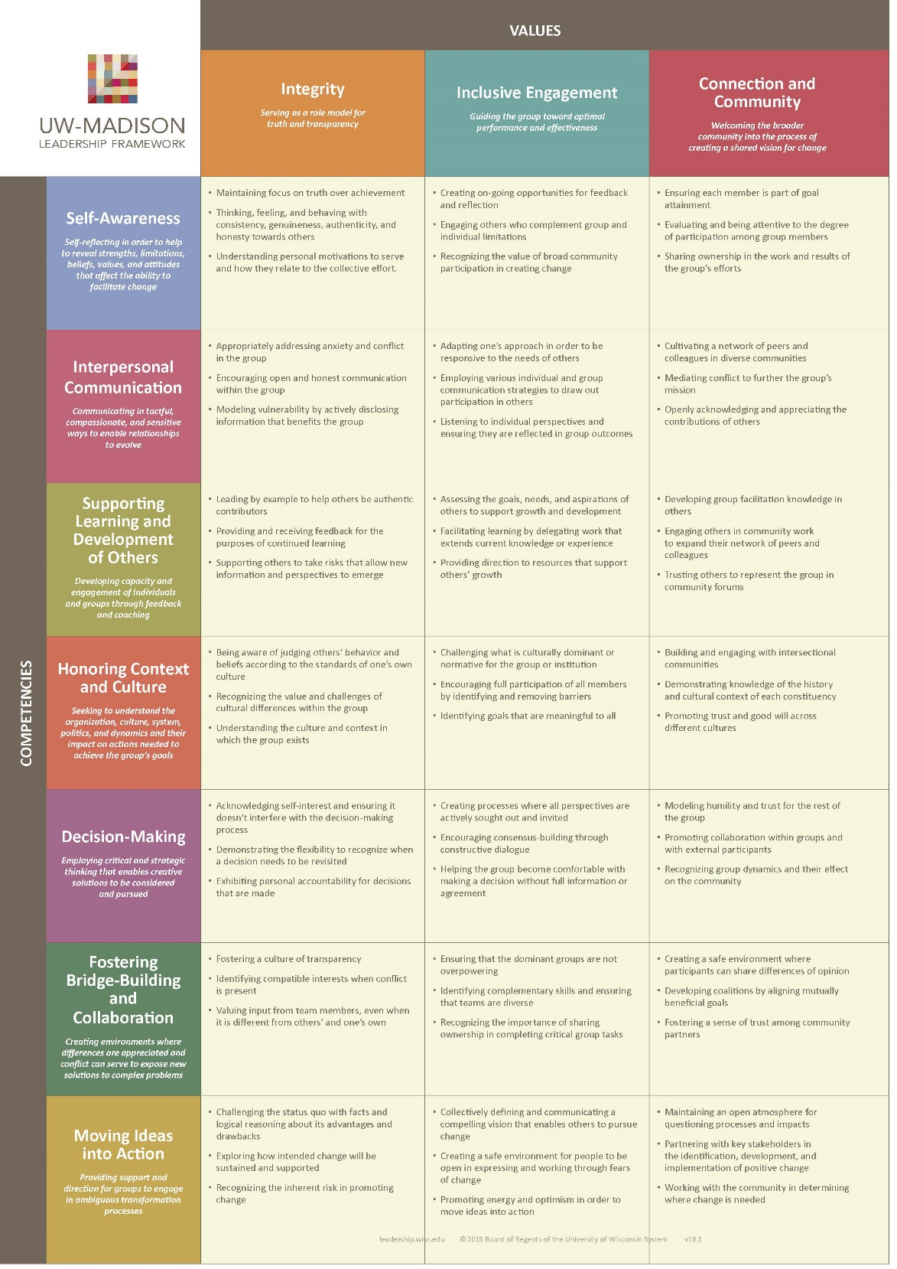
63 Outcomes-detailed, specific, and measurable/identifiable positive changes in beliefs, values, and behaviors.
K-Knowledge: Awareness, information, or understanding about fact, principles, and concepts
S=Skills: Acquired expertise to carry out particular task
A=Abilities: Personal characteristics, attitudes, values, or traits

Slide 9
Integration for employees
Employee Development
Fully Prepared to Lead
Division and/or Team Mission and Vision
Performance Management
Elective Courses

Slide 10

Student Employee/Volunteer Integration
Badger Volunteer
  Hiring Rubric
  Goal Setting
    Executive Team
    Orientation
  Awards Rubric
Adventure Learning Programs
  Facilitator Feedback

Slide 11



Staff/Employee Integration
Digital Printing and Publishing Services
  Develop stretch and growth goals
UW Libraries
  Professional Development Series
  Book Club

Slide 12
Leadership Framework
Activity
What is your definition of
Decision-Making?
Notes:
Data obtained from a 2019 National Association of Colleges and Employers or (NACE) Survey, states that the career competency employer’s value most is critical thinking/problem solving. So with this understanding, we will spend a few moments examining the concept of Decision-Making, one of the competencies within our campus Leadership Framework.
I would like to ask the question - What is your definition of Decision-Making?
What experiences have you had (good or bad) that has informed your definition?
What are some important aspects of this competency you value that should be included in your definition?
You will have 2 minutes to write down your definition.
Pair Share – or groups of three depending on attendance – 5 minutes ( approximately 3.5 minutes per person depending on group size)
Come back together.

Slide 13
Decision-Making
Arriving at decisions that impact others and the organization in which the decisions are made; Employing critical and strategic thinking to enable creative solutions to be considered and pursued; Recognizing that with important systemic dimensions, analysis and ideas from multiple sources give way to implementation and evaluation.
Notes:
Now that you ‘ve had an opportunity to discuss your definition of Decision-Making, here is how the Leadership Framework defines Decision-Making. To be clear your definition is not wrong.
Questions to spur individual reflection;
In comparison, does your definition fit with this definition? Why or why not?
What are the differences?
What are the similarities?
How do you see this competency being utilized in your work and daily life?

Slide 14
Applying the Leadership Framework
Pair Share:
Using the Training & Workshop Development Worksheet
- How do you see the Framework
meeting the needs of your
unit?
Notes:
Applying the Leadership Framework to the workplace!
Introduce the Training & Workshop Development Worksheet. You will be given 5 minutes to fill out the worksheet.
You are asked to;
Select an important competency, key topic or skill that you currently train students. Write that in the box.
Reflect on the training you provide in learning these competencies, topics or skills. Write down 2-3 key takeaways that you hope your students are learning from that training.
Looking at the Framework, do you see any of the values or competencies closely align with what students are learning?
Lastly, in the notes section, based on the values & competencies you have identified, from the section above, review the corresponding outcomes from the LF. How could you use these outcomes in your existing training? Where could the language of the FW add value to an existing training?
In 5 minutes, I’ll call you back and then you’ll have the opportunity to spend some time sharing your reflections with a partner.
Allow pair-sharing for 5 minutes (3.5 minutes per person)
Call pairs back to the main room to wrap up.
Final questions for large group
- How do you see the Framework meeting the needs of your unit?
- Are you able to identify a key take-away from this session?
Questions from the group – next slide

Slide 15
Questions and Conversation!
cfli.wisc.edu
3rd Floor Red Gym
leadership@studentlife.wisc.edu
www. leadership.wisc.edu

