Slide 1
Introduction to the UW-Madison Leadership Certificate Program
Presented by:

Slide 2
Agenda
Leadership Certificate Context & History
Leadership Certificate Structure
Resources
Notes:
Ice Breaker - 6 Degrees of Separation
Find a partner and say the following:
Name
Pronouns (if you want to share)
Something you are passionate about OR makes you happy.
Find a new partner, and state their name and what they shared. You will chain these responses and keep saying all of the names and ideas you shared.
Get in a circle and we will see who remembers the most.

Slide 3
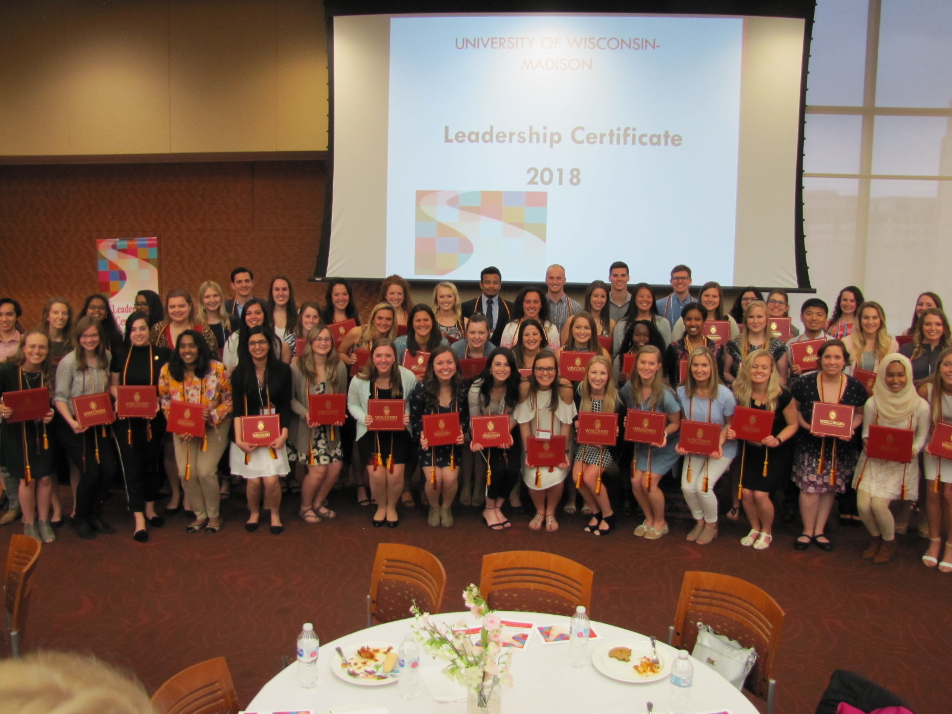
Context & History
Reinforces our commitment to developing student leadership capacity through intentional reflection and engagement in learning, both inside and outside the classroom, for the purpose of meaningful change.
Began in 2002 and certificates first awarded in 2004.
Revised in 2015 to connect with UW-Madison Leadership Framework.

Slide 4

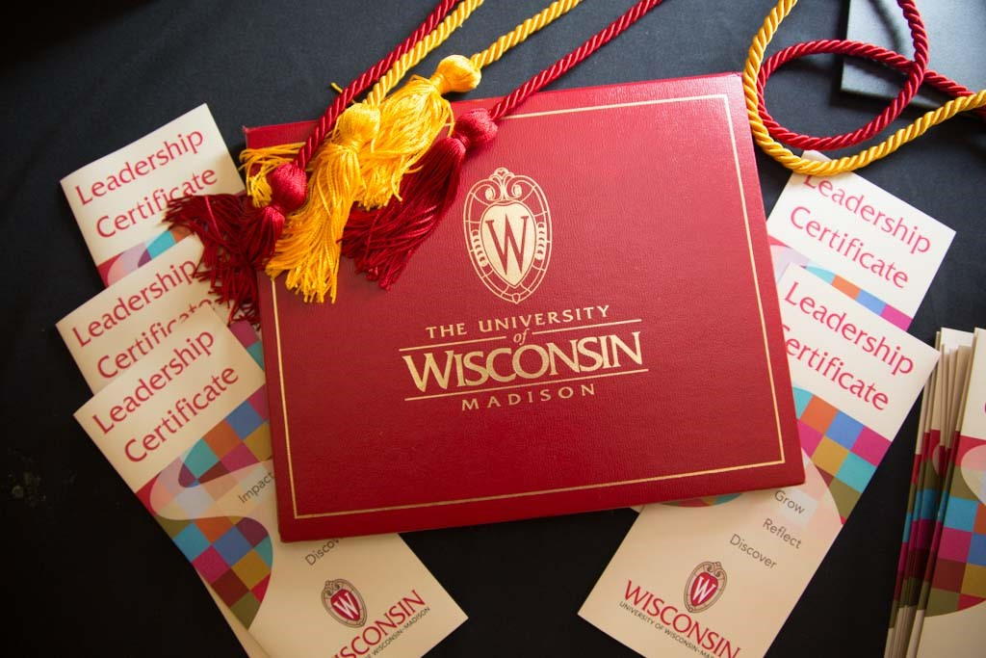
Overview
cfli.wisc.edu/leadership-certificate
Aligns with Leadership Framework
Administered through CfLI
Co-Curricular
Students in good academic standing
Recommend 4 semesters for completion
Notes:
To demonstrate the Framework in action is the UW-Madison Leadership Certificate. The Certificate reflects the competencies, values, and outcomes associated with the UW-Madison Leadership Framework. The Certificate is administered through CfLI. It is a co-curricular, non-academic certificate, in which students (undergraduate or graduate) can showcase and reflect on their leadership and involvement while they are in college. All UW-Madison students are eligible who are in good academic standing within their School/College. Note: Students can complete the Certificate at any time while they are a UW student but we recommend four semesters which promotes real-time reflection and improved quality of work.
Requirements of the Certificate consist of three areas: Involvement, Educational and Reflection of which we will talk about in more detail in a few minutes.

Slide 5
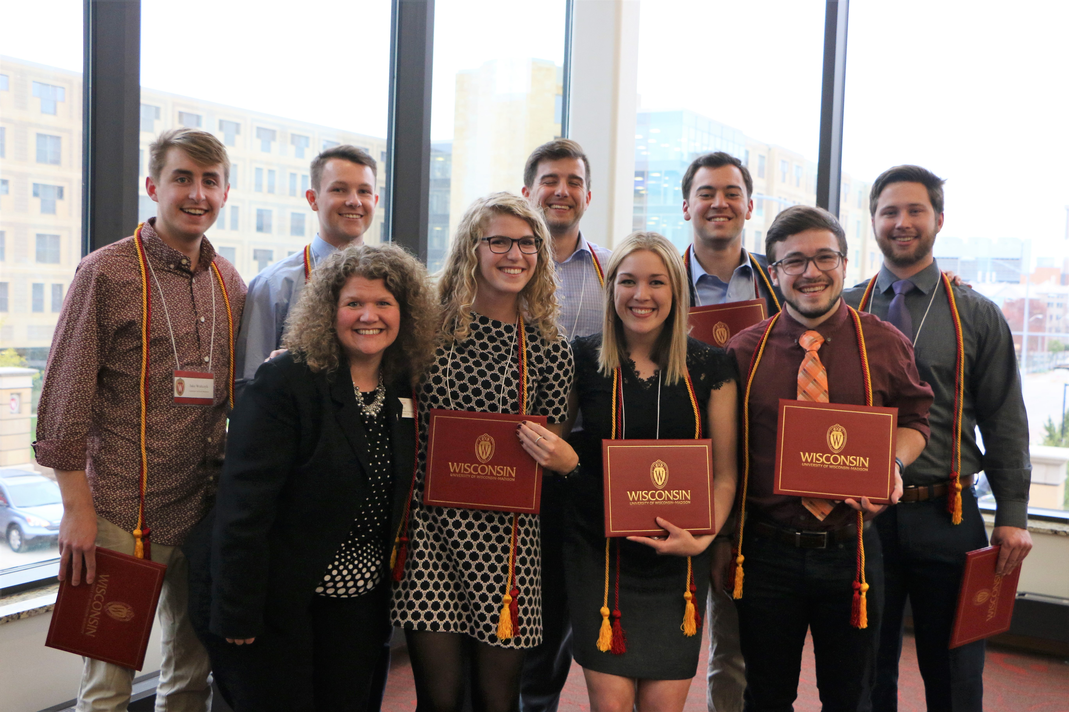
Benefits
cfli.wisc.edu/leadership-certificate
Showcase leadership and involvement experiences
Ceremony, Red/Gold Cords, Certificate of Completion
Include on a resume
Serves as a great talking point in an interview
Transferable skills across disciplines
Notes:
There are many benefits to achieving the Leadership Certificate and to name just a few:
Great way to showcase leadership and involvement experiences while on campus
Students achieve a certificate of completion, attend the certificate ceremony, and receive red & gold cords to wear at graduation
Ability to include on a resume and serves as a great talking point in an interview
Transferable skills

Slide 6
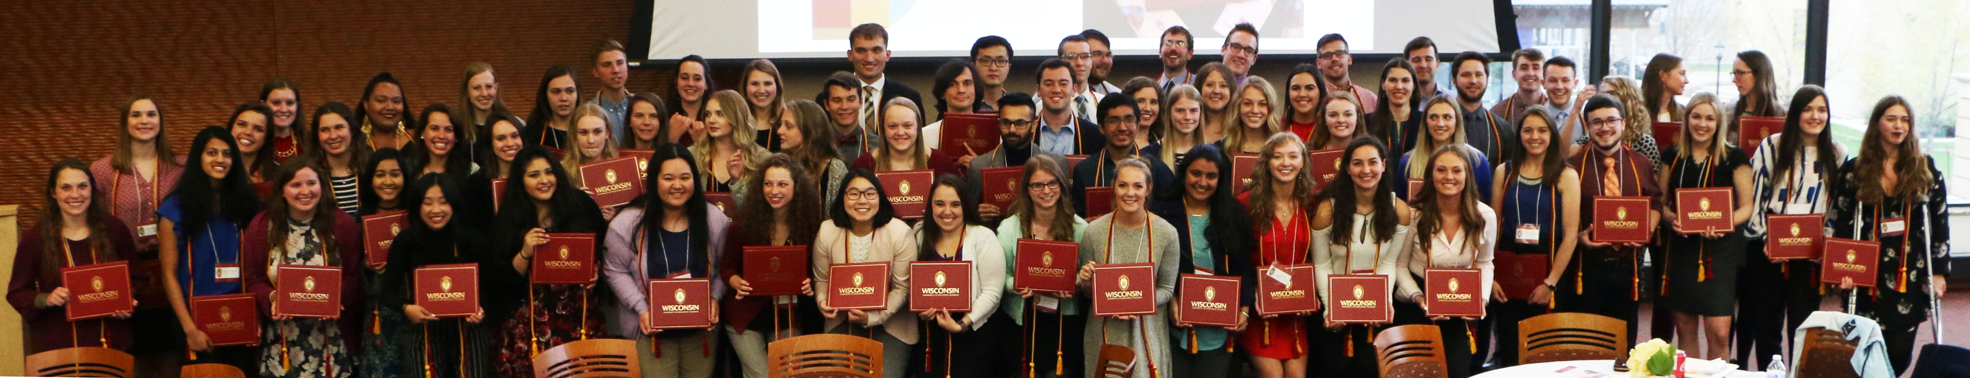
Learning Outcomes
cfli.wisc.edu/leadership-certificate
Increased self-awareness
Gain a greater understanding of leadership-related strengths and areas of improvement
Increased capacity to affect positive change within groups and communities
Ability to apply learned skills
Notes:
What can students expect to learn from going through the Leadership Certificate program?
Increased self-awareness – serves as the foundation for leadership. Understanding who you are as a person and as a leader – So the question is; How can one be a great leader if they don’t know who they are and what they stand for?
Gain a greater understanding of leadership-related strengths and areas of improvement
Increased capacity to affect positive change within groups and communities
Ability to apply learned skills and more prepared for interviews and post-college jobs

Slide 7
Involvement Requirements
cfli.wisc.edu/leadership-certificate
Documentation of 100 hours of leadership experience divided across three areas:
Organizational/Group Leadership (30 hrs. min)
Civic Engagement (30 hrs. min)
Trainings and Workshops (10 hrs. min)
Notes:
So a deeper look into the specific Requirements of the Certificate
The first component is the Involvement Requirements: We ask students to document 100 hours of leadership experience that is divided across three areas. The first one is Organizational/Group Leadership
Organizational/Group Leadership – (50 hours max) These can be a paid or unpaid leadership experiences. Some common examples are: (not exhaustive list)
SOAR New Student Leaders (point out the facilitator in the room)
Emerging Leaders (1st year students)
Internships
Active leadership roles in student orgs
Civic Engagement – (40 hours max) These experiences provide service to and being actively involved with the community. Common examples are: (not exhaustive list)
Badger Volunteers (through the Morgridge Center for Public Service)
Volunteering at the hospital
Habitat for Humanity
Trainings and Workshop – (30 hours max) These are non-credit experiences that includes conferences, seminars, talks etc. that pertain to leadership development (not exhaustive list)
All Campus Leadership Conference
ALPs workshops
Willis Jones Leadership Center – Leadership workshops
Social Justice trainings and workshops though the Multicultural Student Center

Slide 8
Organizational/Group Leadership
cfli.wisc.edu/leadership-certificate
  Paid or unpaid leadership experiences
  Examples:
    Student Leadership Program
    Employment within your unit
    Active leadership roles in student organizations
Notes:
So a deeper look into the specific Requirements of the Certificate
The first component is the Involvement Requirements: We ask students to document 100 hours of leadership experience that is divided across three areas. The first one is Organizational/Group Leadership
Organizational/Group Leadership – (50 hours max) These can be a paid or unpaid leadership experiences. Some common examples are: (not exhaustive list)
SOAR New Student Leaders (point out the facilitator in the room)
Emerging Leaders (1st year students)
Internships
Active leadership roles in student orgs

Slide 9
Civic Engagement
cfli.wisc.edu/leadership-certificate
  Provides service to and being actively involved with the community
  Examples:
    Badger Volunteers
    Employee volunteer outing
    Habitat for Humanity
Notes:
So a deeper look into the specific Requirements of the Certificate
The first component is the Involvement Requirements: We ask students to document 100 hours of leadership experience that is divided across three areas. The first one is Organizational/Group Leadership
Civic Engagement – (40 hours max) These experiences provide service to and being actively involved with the community. Common examples are: (not exhaustive list)
Badger Volunteers (through the Morgridge Center for Public Service)
Volunteering at the hospital
Habitat for Humanity

Slide 10
Trainings and Workshops
cfli.wisc.edu/leadership-certificate
  Non-credit, includes conferences, seminars, talks, etc.
  Examples:
    All Campus Leadership Conference
    Onboarding Training
    Social Justice Trainings/Workshops
Notes:
So a deeper look into the specific Requirements of the Certificate
The first component is the Involvement Requirements: We ask students to document 100 hours of leadership experience that is divided across three areas. The first one is Organizational/Group Leadership
Trainings and Workshop – (30 hours max) These are non-credit experiences that includes conferences, seminars, talks etc. that pertain to leadership development (not exhaustive list)
All Campus Leadership Conference
ALPs workshops
Willis Jones Leadership Center – Leadership workshops
Social Justice trainings and workshops though the Multicultural Student Center

Slide 11
Educational Requirements
cfli.wisc.edu/leadership-certificate
Academic Course
  1 academic course in Leadership or Global and Cultural Competence
Online Learning Modules
  3 Ted Talks in Leadership and Global and Cultural Competence
Notes:
The Educational Requirements:
As was mentioned earlier the Certificate is co-curricular but it does have a academic component.
Students are required to take one course in either Leadership or Global and Cultural Competence (not both) and receive a B or better (Your student may be taking something already within their ethnic studies that would meet the requirement for this area) and also students are to complete 3 Online Learning Modules which are another mode of leadership learning that consists of website or Ted Talk leadership topics. Students are then asked to reflect and write a one-page paper on what they’ve learned and how this learning connects with the UW-Madison Leadership Framework as well as their own personal experiences.

Slide 12
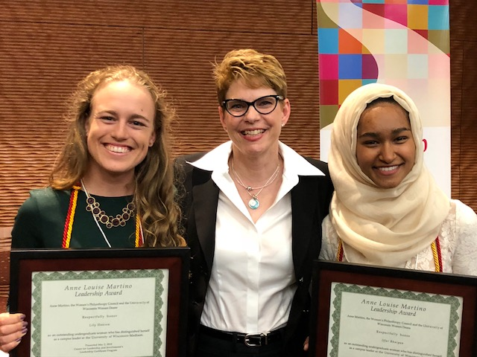
UW-Madison Leadership Certificate
cfli.wisc.edu/leadership-certificate
Reflection Requirements:
Competency Essay
  addresses all seven leadership competencies
  highlights students’ strengths and future areas of growth
“Leadership for Change” Capstone
  paper (2000-2500 words)
  or presentation (20 minutes)
Notes:
Reflection Requirements – is the core of the Certificate where students are able to articulate what they’ve learned through their various experiences and this is shared through the following:
Competency essay: addresses all 7 leadership competencies and examines which competency or competencies the student feels most confident in and why, least confident in and why, and then choose one and convey how you will continue to grow in that area
“Leadership for Change” Capstone: This is the last piece of the Certificate reflection requirements but a very important one. Through the Capstone project, students are asked to identify something they would like to change in a positive way by using one value and three-four competencies to inform this change. This change initiative should be something the student is passionate about and in any context such as; within their student organization, at work, school or even at home. The Capstone serves as a means for the student to apply what they have learned to something bigger.
The Capstone can either be:
a paper (2,000-2,500 words) or presentation (20 minutes)

Slide 13
Getting Started
cfli.wisc.edu/leadership-certificate
Step 1 – Informational session/view online
Step 2 – Leadership self-assessment
Step 3 – Advising appointment
  Certificate requirements
  Leadership experiences
  Canvas site
  Answering specific questions
Notes:
So you might be asking yourself….how would my student get started in working toward achieving the Leadership Certificate? To start the process there are three steps.
Attend an informational session (three per semester) or view the presentation online (located on the cfli website).
The second step is to complete a self-assessment activity which is located on the cfli website
The third step is to schedule and advising appointment with a CfLI staff member who works in the leadership area
During the advising appointment the advisor will cover the following important information
Talk with your student about the Certificate requirements
Discuss what your student has learned through their various leadership experiences and which Involvement area they would fit
Provide access to the Canvas site where the Leadership Certificate application is housed
Answer any specific questions your student may have

Slide 14
Resources
Resources
Future Workshops
Program Title | Tier
What are the benefits of building leadership capacity? | 1
Introduction to the UW-Madison Leadership Framework | 2
Integrating Leadership Studies into Employee Training | 2
Utilizing the Leadership Online Self-Assessment Tool | 2
Integrating the UW-Madison Leadership Framework into Employee Evaluation | 2
Building Leadership Capacity in Students | 2
Monitoring Leadership Capacity in Students | 3
Using the WiGrow System for Student Development | 3
Transformational Change: Making Leadership Development a Unit Priority | 3
Leadership Certificate Pipeline Programs | 3
The Co-Curricular Lens: Using Capstone Projects | 3
Integrate LC Program with Unit
  Attend Leadership Certificate Pipeline Programs Workshop
  E-mail interest to leadership@studentlife.wisc.edu
  https://cfli.wisc.edu/leadership-certificate-info-packet/
Financial Aid Employer Resources
  https://studentjobs.wisc.edu/employer-resources/
Consultation & Support
  https://leadership.wisc.edu/support-2/

Slide 15
QUESTIONS?
leadership@studentlife.wisc.edu

