Slide 1
Engaged Leaders through Employment
Presented by:

Slide 2
Agenda
What is ELE?
Why engage in ELE?
What does ELE offer?
How will I access ELE resources?
Where can I learn more?
Notes:
Ice Breaker - 6 Degrees of Separation
Find a partner and say the following:
Name
Pronouns (if you want to share)
Something you are passionate about OR makes you happy.
Find a new partner, and state their name and what they shared. You will chain these responses and keep saying all of the names and ideas you shared.
Get in a circle and we will see who remembers the most.

Slide 3
What is ELE?
This program aims to support UW-Madison employers in creating and sustaining a work culture that values student leadership development through integration of the UW-Madison Leadership Framework and best practices across campus.
Notes:
10:30 AM

Slide 4
What is ELE?
Differentiating Between:
Technical Skills
Soft Skills
Leadership Development
Practicing student leadership development:
UW-Madison Leadership Framework
Leadership @ UW partners
Campus leadership development efforts
Notes:
10:30 AM

Slide 5
Why engage in ELE?
Committing to embedding leadership development into the Student Employment experience is beneficial to students, supervisors, and campus.
Invest in students’ development & success
Places a value on student leadership
Increase buy-in and productivity of students
Create meaning for students to help reduce employment turnover
Support career preparedness

Slide 6
What does ELE offer?
Leadership Development Workshops
Group work and lessons about leadership development in student employment experience.
Tailored Action Plans
Opportunities to individualize your and your unit’s commitment to this work.
Online Workshop Content
Canvas library you can access with ELE workshop materials.

Slide 7
What does ELE offer?
1:1 Consultations
Meet with Center for Leadership & Involvement leadership development staff to plan your approach.
Leadership @ UW Community of Practice
Monthly check-ins with campus partners to receive feedback on your action plans and program implementation.

Slide 8
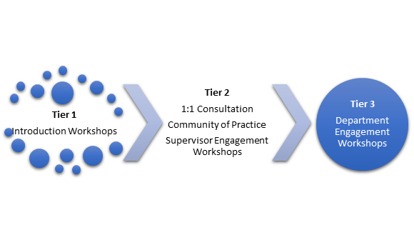
What does ELE offer?

Slide 9
Tier 1
An entry into engagement with the Leadership Certificate for student employment, which ties with the Leadership Framework.
Encourage pursuit and provide awareness of the Leadership Certificate.
Communicate requirements and provide resources.
Option of meeting with Center for Leadership & Involvement leadership development staff.

Slide 10
Tier 2
Increased level of engagement with the Leadership Certificate and/or Leadership Framework in areas of onboarding, formal evaluations, and recognition.
Requires supervisor commitment.
Initial meeting with the Center for Leadership & Involvement leadership development staff.
Ongoing consultations with Leadership @ UW Community of Practice.
Intentionally integrate components of Leadership Certificate into onboarding/training.
Use of leadership self-assessment tool.
Incorporation of Leadership Framework language into evaluation & recognition.

Slide 11
Tier 3
Extended commitment to the development of student leadership capacity.
Requires significant commitment from department and supervisor.
Initial meeting with the Center for Leadership & Involvement leadership development staff.
Ongoing consultations with Leadership @ UW Community of Practice.
Integrate leadership development as a key value.
Components of Leadership Certificate integrated into recruitment and ongoing support.
Components of Leadership Framework integrated into recruitment and ongoing support.
Civic engagement is integrated into employment experience.

Slide 12
What does ELE offer?

Slide 13
How will I access ELE resources?
Program Title | Tier
Introduction to the UW-Madison Leadership Certificate Program | 1
What are the benefits of building leadership capacity? | 1
Introduction to the UW-Madison Leadership Framework | 2
Using the WiGrow System for Student Development | 3
Upcoming workshops for Spring 2020.
In-person
Virtual
Access to online workshop library.
Contacting the CfLI Team.

Slide 14
How will I access ELE resources?
Program Title | Tier
Integrating Leadership Studies into Employee Training | 2
Utilizing the Leadership Online Self-Assessment Tool | 2
Integrating the UW-Madison Leadership Framework into Employee Evaluation | 2
Building Leadership Capacity in Students | 2
Monitoring Leadership Capacity in Students | 3
Transformational Change: Making Leadership Development a Unit Priority | 3
Leadership Certificate Pipeline Programs | 3
The Co-Curricular Lens: Using Capstone Projects | 3

Slide 15
QUESTIONS?
https://leadership.wisc.edu/support-2/
leadership@studentlife.wisc.edu

