Slide 1
Last Steps to Completing your Doctoral Degree Updated 11-14-21

Slide 2
Degree Coordinators:
Elena Hsu, PhD
elena.hsu@wisc.edu
Alexandra Walter, PhD,
alexandra.walter@wisc.edu

Slide 3
Today we will discuss the following:
1. Rules for dissertators
2. The five-year rule
3. Copyright
4. Deadlines
5. Dissertation formatting requirements
6. PhD Committee requirements
7. Requesting a PhD warrant and
submitting your dissertation electronically.
8. Electronic submissions of dissertations
9. Embargoes

Slide 4
Dissertators must register continuously until they graduate. For detailed information, check Dissertator Status in the Graduate School Academic Policies & Procedures: https://grad.wisc.edu/documents/dissertator-status/

Slide 5
Post prelims
You have 5 years from the date you took prelims to defend and deposit your dissertation at the Grad School.

Slide 6
Five-year rule
If your department/advisor/committee believes that an appeal of the time limit is appropriate, the advisor may submit a written request to Alexandra Walter, explaining the reason why it is taking more than 5 years to complete the degree, how you are staying active in the field, and when you will defend and deposit your dissertation at the GS.

Slide 7
Automatic 8-month extension
Since the beginning of the pandemic, doctoral students have an additional 8 months, added to the five-year limit, to complete the dissertation without needing an extension request from the advisor.

Slide 8
Copyright
Obtain permission for the published and copyrighted materials, data, figures, or images you intend to reproduce, reprint, or translate in your dissertation.
More information about copyright is available on the Memorial library website:
https://www.library.wisc.edu/research-support/scholarly-communication/copyright-resources/copyright-basics/

Slide 9
Graduate School deadlines https://grad.wisc.edu/deadlines/
Submit your dissertation by the deadline. You are required to submit your dissertation on or before the deadline in order to complete your degree for the given term. https://grad.wisc.edu/deadlines/

Slide 10
This is a strict rule. You must click submit by midnight of the deadline. The policy is that if you click submit even one minute late, you graduate the next semester. If it is the end of the window period, you will be expected to enroll for the next semester.

Slide 11
You are not done until you click submit. Make sure you receive an email confirming your dissertation submission.

Slide 12
The ProQuest website records the time of every action you make.

Slide 13
Submit in advance in case you have questions or technical problems.

Slide 14
Enrollment requirements
Register for the term in which you want to complete your degree, including summer.

Slide 15
Window period
Are you graduating in the window period? If you want to graduate in the window period, remember that your degree will be conferred for the upcoming term, but you do not have to register for the upcoming term.

Slide 16
Formatting your dissertation
Please study the Graduate School formatting requirements carefully:
https://grad.wisc.edu/current-students/doctoral-guide/

Slide 17
Title page format
Follow the sample online exactly, including the date of your final defense and your committee members at the bottom of the page:
https://grad.wisc.edu/current-students/doctoral-guide/

Slide 18
Prechecks via email
Prechecks are welcome and encouraged; it is a chance for you to check formatting before you officially submit your dissertation.
During the pandemic prechecks are offered via email only.
Send your dissertation to Alexandra Walter (alexandra.walter@wisc.edu)
Feel free to send a pdf of the entire dissertation.

Slide 19
Form your final oral examination committee (degree committee; defense committee)
You can find Grad School PhD committee rules on our website under Committees:
https://grad.wisc.edu/documents/committees/

Slide 20
Remote defenses
Remote defenses are quite common across campus.
Collect electronic signatures on the PhD warrant after the defense.
All signatures should be obtained on the one document.

Slide 21
PhD Committees
Do you know the rules for PhD committees?

Slide 22
At least 4 members
A Ph.D. final oral committee must have at least 4 members, 3 of whom must be UW-Madison Graduate Faculty or former Graduate Faculty up to one year after resignation or retirement. If you have more than four members on the committee, the additional member(s) should vote and sign the degree warrant too.

Slide 23
A minimum of 4 members is a change in Graduate School policy.
Your department has the right to continue to require 5 members.

Slide 24
Check with your department/advisor to see if your department has additional rules on the formation of the final oral committee.

Slide 25
Outside member
At least one of the four (or five or more) members must represent a different UW-Madison graduate program outside of your major field.

Slide 26
In other words, the committee must have members from at least two University of Wisconsin—Madison graduate programs.

Slide 27
Chair of committee
Your advisor chairs the committee. You can also have another faculty member co-chair the committee if your department approves it.

Slide 28
Retired or resigned advisor
If your advisor has retired or resigned, she or he has one year to remain “current,” after which you will need to add a co-advisor, who is current UW graduate faculty in your department.

Slide 29
If one of the members of your committee has retired, she or he remains current for one year. After one year, as long as the other 3 are current UW graduate faculty, the retired faculty member can remain on the committee.

Slide 30
If you have more than one member who has retired or resigned more than a year ago, you will need to add another member (or more) so that you have a minimum of 3 current graduate faculty.

Slide 31
Readers and nonreaders
The Graduate School requires a minimum of three (3) readers on the committee.

Slide 32
Dissenting vote
To pass the oral exam/defense, receive no more than one dissenting vote from the oral committee. A missing signature is considered a dissent.

Slide 33
If a committee member is not in town. . .
If any committee members participate via Zoom, some other platform, or teleconference, or skip out of town before your warrant is signed, no worries. The Grad School has e-signatures and each member can and must sign.

Slide 34
Request the final Ph.D. warrant
Request the final Ph.D. warrant at least 3 weeks before your oral exam/defense and check the degree deadline(s).

Slide 35
Submitting the PhD warrant
You are responsible for submitting your signed warrant with your dissertation.
A scanned copy is fine.
Upload the warrant at the ProQuest website when you submit your dissertation to the Graduate School along with the survey completion certificates.

Slide 36
Do not mail doctoral warrants
Please do not send a doctoral warrant to the Grad School.
Thank you!

Slide 37
Submitting your dissertation electronically
You must submit your dissertation to the Graduate School and upload your warrant by the deadline in order to graduate in the final term in which you are enrolled.

Slide 38
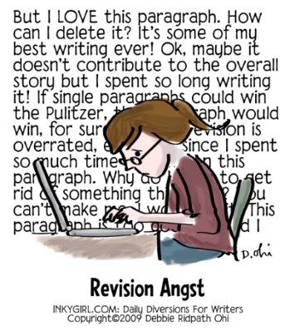
Formatting changes
If the Graduate School requires formatting changes after the dissertation has been submitted, you will receive an email explaining what you must do.
Regarding the timing, you will need to follow the instructions in the email as soon as possible.
You are responsible for following instructions in the emails and on the Graduate School website.

Slide 39
Check your email
After you submit your dissertation, check the email address that you enter when you create an account on the ProQuest website.
Look for an email from the ETD administrator.
Check to ensure that your dissertation has been accepted.

Slide 40
Deposit date
Your official deposit date will be the date you initially submit your dissertation, even if you have to make changes and resubmit.

Slide 41
Final submission is final. After your dissertation has been accepted, you are not allowed to make changes.

Slide 42
ETD
Electronic Theses and Dissertations through ProQuest/UMI.

Slide 43
What to do before you submit your dissertation.
Complete two surveys online and upload your completion certificates with your dissertation.
SED: https://sed-ncses.org/login.aspx
DES: https://uwmadison.co1.qualtrics.com/jfe/form/SV_6tcKhVB6vtjEIPX?Q_JFE=qdg

Slide 44
Before submitting electronically prepare the following:
Full text of the dissertation in pdf format
An abstract of preferably no more than 350 words which you will copy into a textbox
Advisor and other Committee Members’ Names
Have your credit card ready. The minimum fee is $90 for a bound copy to go to Memorial Library.

Slide 45
ETD site: http://www.etdadmin.com/cgi-bin/home

Slide 46
Pay the $90 fee online: https://my.grad.wisc.edu/FeePayment

Slide 47
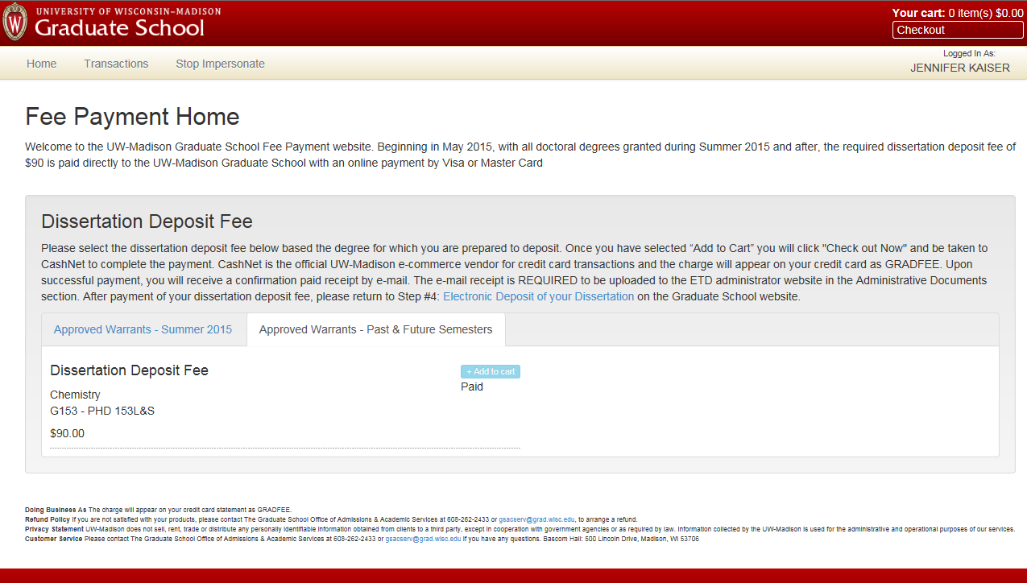

Slide 48
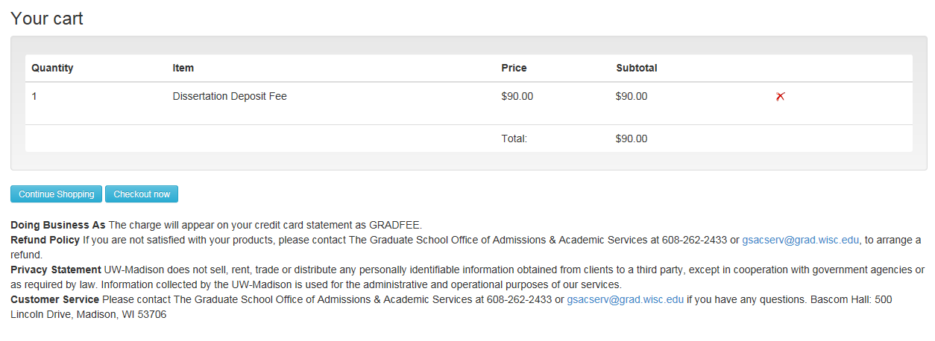

Slide 49
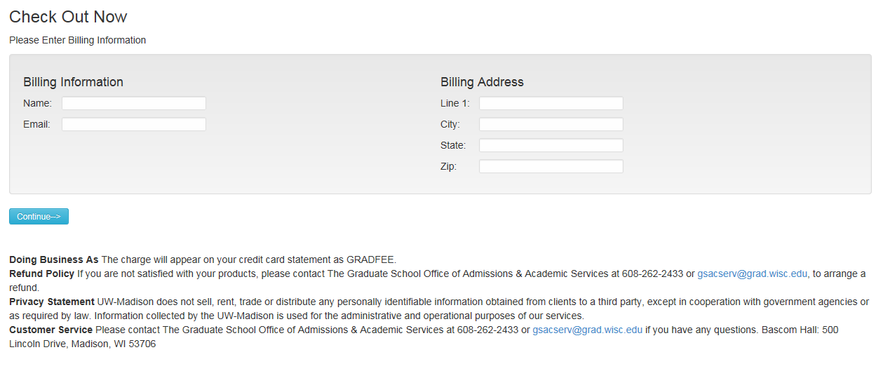

Slide 50
When you submit your dissertation electronically, upload
Your signed warrant.
Two survey completion certificates

Slide 51
FAQ about the Electronic Submission Process

Slide 52
Do authors retain copyright of their dissertations? Yes. By submitting their dissertations in tangible form, authors are automatically covered by copyright law.

Slide 53
What is registration of copyright?

Slide 54
Registration of copyright
A public record of your copyright.
You receive a certificate from the Library of Congress.
If you were to litigate, it is important to be covered for attorney fees and damages.
It costs $75.
You pay when you submit your dissertation.

Slide 55
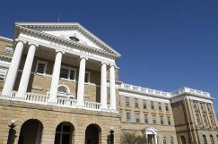
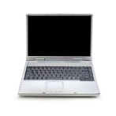
What happens to your dissertation after it is delivered to ProQuest
ProQuest will make available a copy of the work for its university subscribers.
ProQuest will allow web indexing services like Google and Google Books to make a copy of the dissertation.
electronic
University Subscribers

Slide 56
UW Library receives a digital copy of your dissertation simultaneously.
UW Library will automatically receive the digital texts from ProQuest and make them available in Madcat.
UW Library allows Google and Google Books to index and capture dissertations in full text.

Slide 57
Soon after you submit your dissertation to the Graduate School, it will be free, open, and potentially searchable on Google.

Slide 58
Embargoes/Delayed Release
An embargo means you withhold your dissertation from public view.
temporary hold
electronic
University Subscribers

Slide 59
Embargoes
You may choose to embargo your dissertation for 6 months, 1 year, or 2 years.
If you want 3 years, you can mention this in a textbox note.
No special permission is needed for up to 3 years.

Slide 60
More than 3 years
If you would like to embargo your dissertation for more than 3 years, you will need to request special permission from the AD in writing, not at the time of your final review, but about a month before the 3-year embargo expires. You will need to provide proof from a publisher that more time is needed.

Slide 61
Timing of Degree

Slide 62
Your degree will be posted on your transcript 4-6 weeks after degree deadline.

Slide 63
Your diploma will be mailed to you 12-14 weeks after degree deadline. Please be sure and update your address in your student center.

Slide 64
Degree Completion letters
The Registrar’s Office handles Degree Completion Letters. If you have completed all degree requirements and deposited your thesis or dissertation and are waiting until the next degree conferral date to receive your degree, you may request and receive a letter indicating that all requirements have been completed. All grades from the semester in which you are depositing your dissertation (and all other outstanding grades) must be reported to the Graduate School before you can receive a completion letter. A student may bring the completed grade change form to the final review if a degree completion letter will be needed.

Slide 65
Timing of completion letters
Before requesting a degree completion letter, please check to see that your final grade has been submitted.

Slide 66
Timing of degree posting
Please allow 4 – 6 business days after degree deadline for your degree to be posted.
In the meantime, please ensure that your final grade has been posted on your transcript (S for satisfactory if you are enrolled for research).

Slide 67
Posting degrees
The Graduate School and the Registrar’s Office have a lot of work to do to post your degrees.
Please know we work as fast as we can to serve your needs but degrees cannot be posted instantaneously.
Thank you for your patience!

